Slide 1
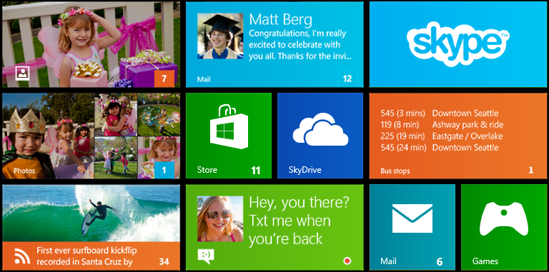
Logo
Badge
Name

Slide 2


Slide 3
Server Process
Other Services
Database
Mobile Service
Mobile Devices
Client App via Windows
Periodic Notification Service
Other Clients
Other Services
Web App

Slide 4



Running App
Channel Request API
Web Service
Send channel to web service
Send update
Suspended or not running
Push updates to client
WNS
App background task can process notification if desired

